Slide 1


NOTPETYA__2 PRESENTS

Slide 2


TEAM NOTPETYA__2
HARSH DEWANGAN
KAVYA DEWANGAN
MANYA PANSARI
CHANDRAKANT DARIYANA
OUR MENTORS :- Mrs.Anju Pandey Mam & Mr. Lakshya Namdeo Sir

Slide 3
DEEPFAKE DETECTOR
PROBLEM OVERVIEW :-
SOCIAL PROBLEMS FROM DEEPFAKE IMAGES
Misinformation - It spreads false information about people’s life.
Defamation / Harass - People’s fake images can destroy their reputation by showing them in embrassing or illegal situations.
Loss of trust / Mental stress - Nowadays deepfake becomes common , people may stop believing even in real images. Victims of deepfakes , specially used for revenge or explicit content,may face trauma, anxiety, depression.

Slide 4
LEGAL AND ETHICAL PROBLEMS
Privacy violations - Without consent using someone’s face.
Cyberbullying and Blackmail - It can be used to threaten or to make money from victims by blackmailing them.
Lack of clear law - Many countries don’t have strong legal framework to handle those scams or crimes.
TECHNOLOGY PROLEMS
Detection difficulty - As technology improves fastly it becomes harder to detect deepfakes , & leave security tools lag behind.

Slide 5
OUR SOLUTION
Victims : Prove their credibility
Public : Verify if info is true or false
Authorities : Detect early and stop spread
Impact : Prevent harm, protect reputation

Slide 6
OUR SOLUTION
PROCESS :
It is a website to detect the images it real or fake
Upload : user gives an images
Preprocess : system extracts frames for analysis
Feature check : AI looks for unnatural patterns or inconsistencies
AI Analysis : model compares with real vs fake patterns
Result : shows if content is Real or Fake with confidence.

Slide 7
KEY FEATURES
CNN based image identification.
Also tells how confident it is in the decision.
User friendly UI
Potential to become API
Becomes better as time passes as the model trains itself and tests the images.

Slide 8
TECH STACK USED
PYTHON LANGUAGE
CNN METHODOLOGY
STREAMLIT FOR UI
DATASETS : SELF MADE

Slide 9
UI FLOW
CNN BASED IMAGE EVALUATION
USER INPUT
OUTPUTTING RESULT AND JUDGEMENT CONFIDENCE
IDENTIFICATION AS DEEPFAKE OR REAL

Slide 10
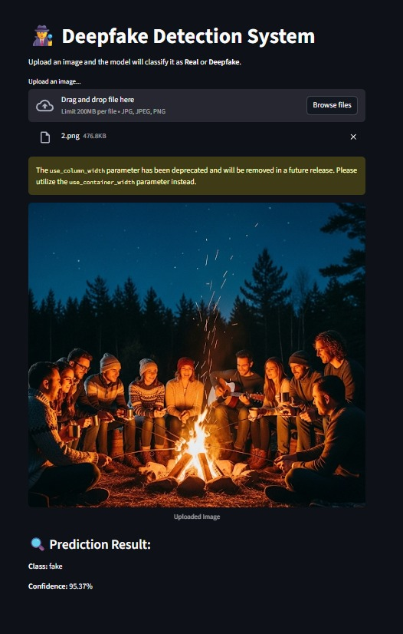
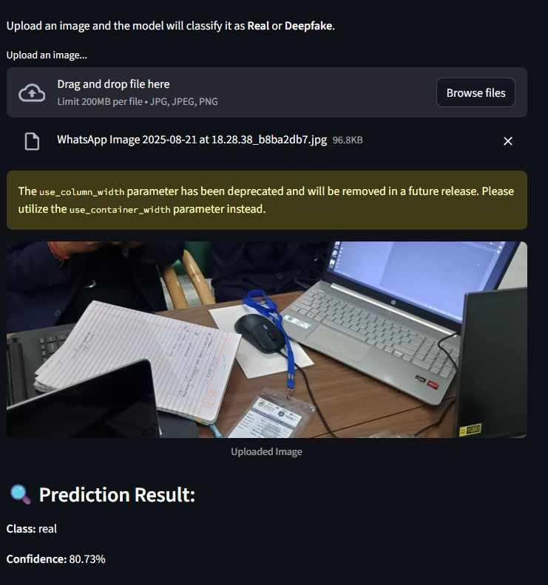
SCREENSHOTS
NOW THE FAKE AND THE REAL IMAGE DETECTION BEGINS.

Slide 11
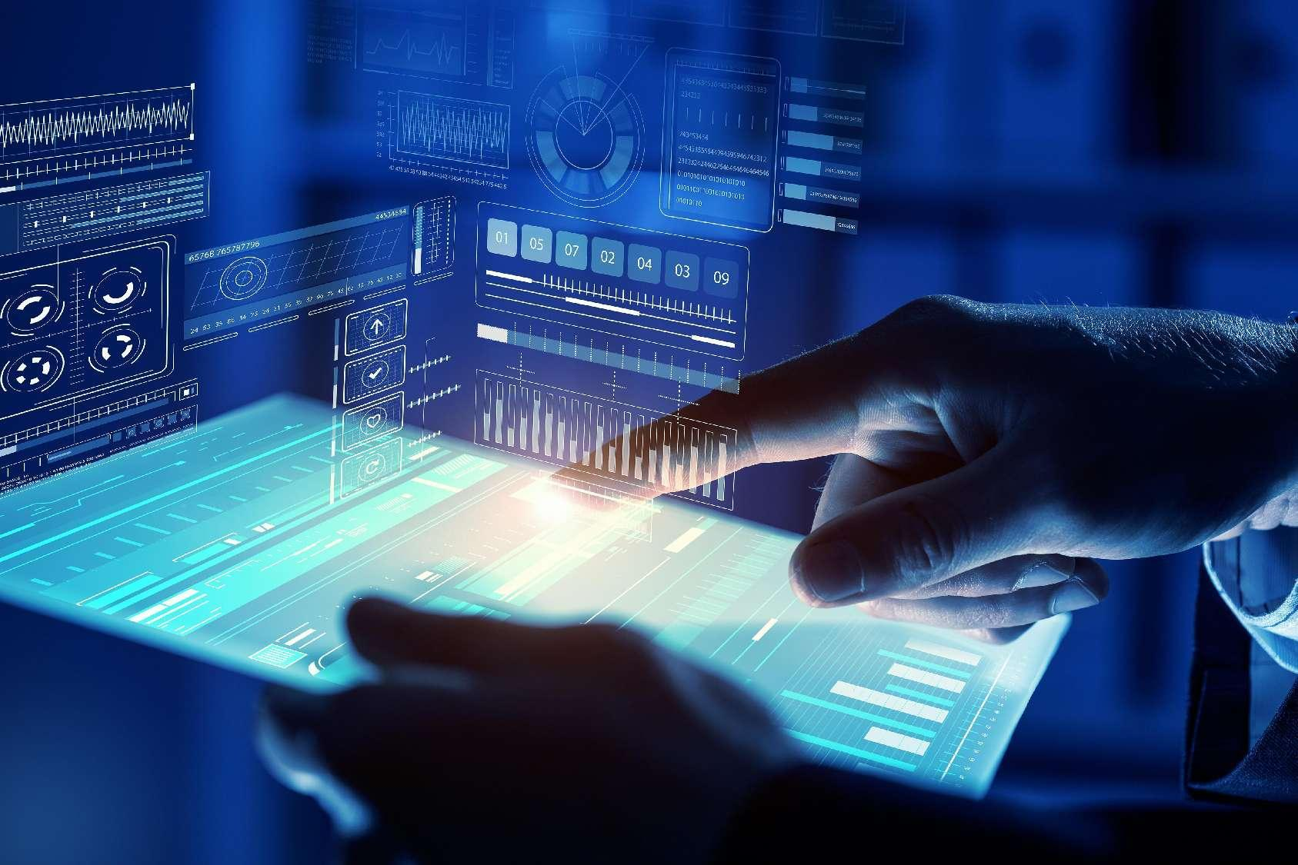
CHALLENGES AND LEARNINGS
LOW QUALITY /MISLABLED IMAGES DISTORT LEARNING
DATA LOADING, CNN TRAINING,SPLITTING,PREPROCESSING
SMALL DATASETS -MEMORIZATION INSTEAD OF GENERALIZATION
IMAGE PROCESSING KNOWLEDGE

Slide 12
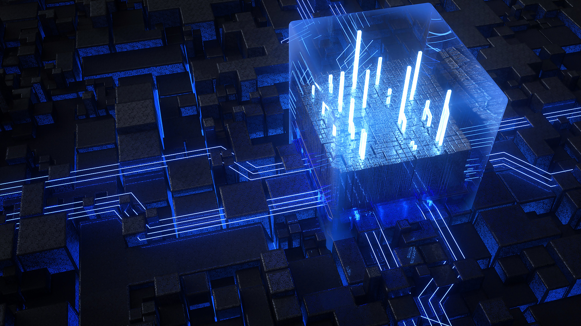



FUTURE SCOPE
Real-time deepfake detection for live streaming.
Stronger AI models against evolving deepfakes.
Improving dataset diversity’
Public awareness tools media platforms.
Legal and ethical frameworks for misuse prevention.

Slide 13
TEAM ROLES
1. HARSH DEWANGAN (TEAM LEADER)
Backend , UI design , Model training , Documentation.
2. KAVYA DEWANGAN
Backend , Model training , UI Design , Documentation.
3. MANYA PANSARI
Documentation , Frontend.
4. CHANDRAKANT DARIYANA
Documentation , Frontend

Slide 14

THE END
THANK YOU

